Slide 1












Twitter (X) API
Product Name
Fetched Product Tweets Data
KPIs
Language Models
Emotions
Criticisms
Main Topics

Slide 2



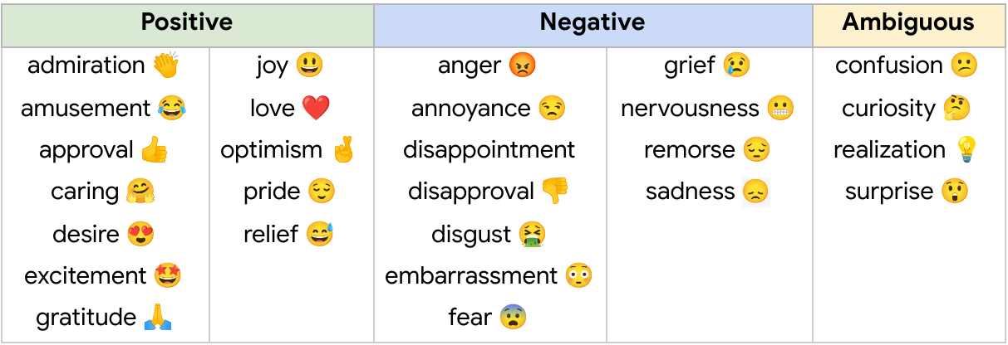




Activities
Sentiments
Emotions
Volume
Engagement
Influence
Positive
Negative

